Slide 1

Evidence from Publicly Available HFEA Data: How Male Age and Treatment Variation Affect Infertility Treatment Outcome
Community Project BUSA 649
Presented to:
Prof. Juan Serpa, Prof. Seang Lin Tan
By:
Zhicheng Zhong

Slide 2
Executive Summary
Global fertility decline has been a concern to policy makers and healthcare researchers. As more and more people in the modern society choose to prioritize career over founding a family and raising children, the child-bearing age for both women and men is postponed. In Vitro Fertilization has proved to be an effective way to help couples with infertility issues conceive babies. The effect of male age on the treatment success rate is still unclear. OriginElle Fertility Center as a pioneer in this domain seeks to unveil the male age puzzle in infertility treatment.
This project seeks to spearhead the efforts to uncover the relationship between male age and IVF treatment outcomes. It explores the publicly available UK the Human Fertilisation and Embryology Authority (HFEA) data to understand the quality of data and the kind of questions that it allows to answer. Even though academic publication is not the goal of this project, it provides several angles from which to tackle the problem and aims to inspire and facilitate the research work by employed researchers at OrigiElle Fertility Center, which will ultimately lead to published paper(s).
The project yielded two cleaned datasets: one for the period 1991-2016 focusing on cycles that involve male sperm donors and female patients, the other for 2017-2018 focusing on cycles that involve male partners and female patients. Two Power BI dashboard files are created for each cleaned dataset respectively to visualize the trend of treatment success and its relationship with age and treatment variations. Statistical tests were then conducted to validate/invalidate the spotted relationships. Empirical evidence from 2017-2018 suggests that older male partners may negatively impact IVF treatment outcomes. However, data from HFEA between 1991-2016 shows no evidence that increasing male donor sperm age (18-45) negatively affects IVF success rates. It is unlikely that the 2009 legislative change on gamete freezing duration positively affects IVF success rates, though further research is warranted to understand why. Preimplantation genetic testing (PGT) in women over 35 years old leads to higher clinical pregnancy and live birth rates, while elective single embryo transfer (eSET) is not effective for women in this age group. Additionally, machine learning models were built and fine tuned on the two datasets, which yielded results that echo the statistical findings.

Slide 3
Introduction and Value of the Project
Why Infertility Treatment matters to the Sustainability of Human Civilization
What value this project provides
One heterosexual couple out of 6 has difficulty conceiving babies and need to receive infertility treatment
It is the right of all couples and individuals to have children through In-Vitro Fertilization (IVF)
Global fertility decline is threatening the sustainability of economy and survival of the human species. The total fertility rate (TFR) globally has reduced from around 5 children for each female in 1950 to 2.2 children in 2021, below the TFR rate of 2.1 births per female. Half the nations have fertility rate below 2.1 (Institute for Health Metrics and Evaluation, 2024)
Understand the publicly available UK Human Fertilization & Embryology Authority (HFEA) data which contains the results of IVF outcome from 1991 when the database started until 2018 (last year when data publicly available), advise on whether the paid version of database is worth purchasing
Analyze the interactions between male age and treatment-specific factors and their impact on cycle/treatment outcomes
Draw insights to inspire more academic research by employed researchers and to better serve the community of OriginElle Fertility Center

Slide 4

Data Overview
1991-2016: Aggregated data of the same set of 94 variables over 25 years. Data of male age only available for cycles when donor sperm was used, but not for partner sperm.
2017-2018: Different data variables vis-à-vis data till 2016. Most treatment cycles used sperm from patients’ partner. Contains Patient and Partners’ Sex and Ethnicity.
For 1991-2016 data, only cycles that use egg from patient and sperm from donors are kept to study the effect of male age on fertility success
For 2017-2018 data, only cycles that use egg from patient and sperm from male partners are kept to study the effect of ethnic factors in addition to males’ age
152825 cycles
235614 cycles
227284 cycles
Merge
1135903 cycles
265103 cycles
Only IVF cycles
Processing and Cleaning
337109 cycles
158519 cycles
48799 cycles
Processing
169616 cycles
130431 cycles
Data Source: https://www.hfea.gov.uk/about-us/publications/research-and-data/

Slide 5
Data Preparation and Cleaning
Keep only the IVF cycles in Type of Treatment. For 1991-2016 data, keep cycles that used donor sperm and thus have data available in sperm donor age at registration. For 2017-2018 data, keep cycles that used partner sperm and thus have data available in Partner Age
For Early Outcome, string values that contain “Pulsation Seen” are converted to 1 otherwise 0. For Live Birth Occurrence, fill in the nulls with 0 to form a binary variable. For Birth Weight, take the lower end of a birth range to be the numerical value
For Sperm Age at Registration, denote the range according to the text descriptions. For Partner Age and Patient Age at Treatment, drop the records that contain null values and 999 for data missing
Create a new column named is_ICSI from the Special Treatment Type column, convert any string values that contain “ICSI” to 1 otherwise 0. Fill in null values in Elective Single Embryo Transfer with 0. Create a new column PGT that equals 1 if any of the columns PGS and PGD equals 1 otherwise 0
Check for records that show partner as female and Sperms from partner, records that have birth occurrence as 0 and baby birth weight as non-null values. Since they account for less than 3% of the data, these records are manually dropped from the datasets.
In columns such as Fresh Egg Collected, Fresh Egg Stored, Total Embryos Created, there exists values of mixed data types pointing to same thing. Data entry inconsistency impedes model testing and therefore was fixed manually by inspecting unique values and unifying the format by creating a mapping dictionary
The original 1991-2016 dataset has 95 columns, the original 2017-2018 dataset has 61 columns. After processing, some new columns are created. Those columns that contain one unique value are dropped, such as treatment type, Sperm From and Egg From
Filtering of Treatment Cycles
Processing of Dependent Variable
Processing of Age Variables
Processing of Treatment Variables
Drop Irrelevant Columns
Check for Discrepancies
Processing of Data Type Inconsistencies

Slide 6
Methodology
Significance Testing using age and factor dummies independent variables and binary dependent variable (both live birth and early outcome)
Multivariate Logistic Regression (Client’s Request): allows for the inclusion of multiple predictor variables to test both the independent effects and that of interaction terms to see the combined effects. Provides coefficients and p-values for statistical significance and the direction of impact. Positive coefficient values suggest increased chance, vice versa.
Difference-in-difference regression: on top of the multivariate logistic regression, create treatment and interaction terms to test whether the 2009 reform has effects on treatment outcomes
Tree-Based Models: Since the datasets contain many discrete and categorical variables, tree-based models such as random forest and boosting models tend to perform better. Both classifiers are regressors were used to predict binary birth outcome and discrete birth weight respectively
K Nearest-Neighbors: If age and treatment factors bear relevance to successful births, the successful treatment cycles will share common traits in the HFEA data and would be closer to one another in a high dimensional feature space
Machine Learning Prediction Models to predict successful birth and birth weight (Nice-to-have)

Slide 7
Dependent and Independent Variables for Statistical Testing
Independent Variables
Dependent Variables
Age (Categorical)
Treatment Variations (Binary)
Pregnancy and Birth
Sperm Donor Age at Registration (1991-2016): categorical variable containing <= 20, 21-25, 26-30, 31-35, 36-40, 41-45. <= 20 is used as reference group while the rest are used as dummy
Partner Age (2017-2018): categorical variable which contains 18-34, 35-37, 38-39, 40-42, 43-44, 45-50, 51-55, 56-60, >60. 18-34 is used as reference group while the rest are used as dummy
Patient Age at Treatment (1991-2018): categorical variable containing 18-34, 35-37, 38-39, 40-42, 43-44, 45-50. 18-34 is used as reference group while the rest are used as dummy in testing
Binary Variable Is_ICSI: IVF (In Vitro Fertilization, denoted as 0): egg and sperm are placed together in a dish and allowed to fertilize naturally. ICSI (Intracytoplasmic Sperm Injection, denoted as 1): a single sperm is injected directly into the egg using a microscopic needle.
Binary Variable PGT (Preimplantation Genetic Testing): 1. PGS (Preimplantation Genetic Screening): Screens biopsied embryo cells for chromosomal abnormalities without known inherited disorders. 2. PGD (Preimplantation Genetic Diagnosis): Detects specific single gene defects likely to be inherited from parents.
Binary Variable Elective Single Embryo Transfer (eSET): Only one embryo is transferred into the uterus of patient with the intention of achieving a singleton pregnancy to minimize the risks associated with multiple pregnancies, such as premature birth, low birth weight, and other complications for both the mother and the babies.
Early Outcome (Binary): 0 for failure; 1 for intrauterine fetal pulsation seen, equivalent to successful pregnancy
Live Birth Occurrence (Binary):0 for failure; 1 for live birth seen. Not all pregnancies translate to live birth despite high correlation
Baby Weight (lower end of each range): i.e. 'Between 3.0kg and 3.49Kg’ converted to numerical type 3.0, in machine learning only

Slide 8
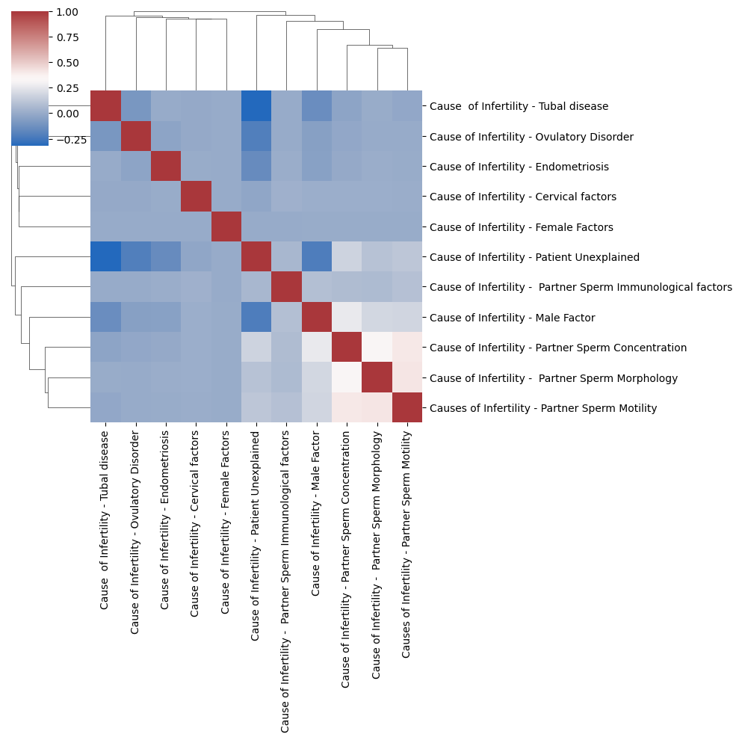
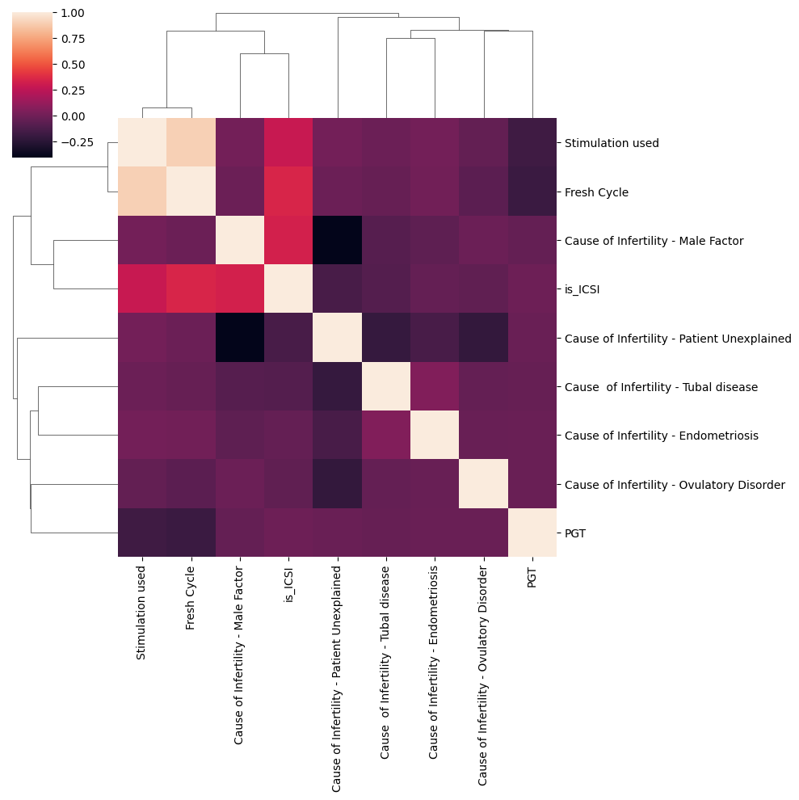
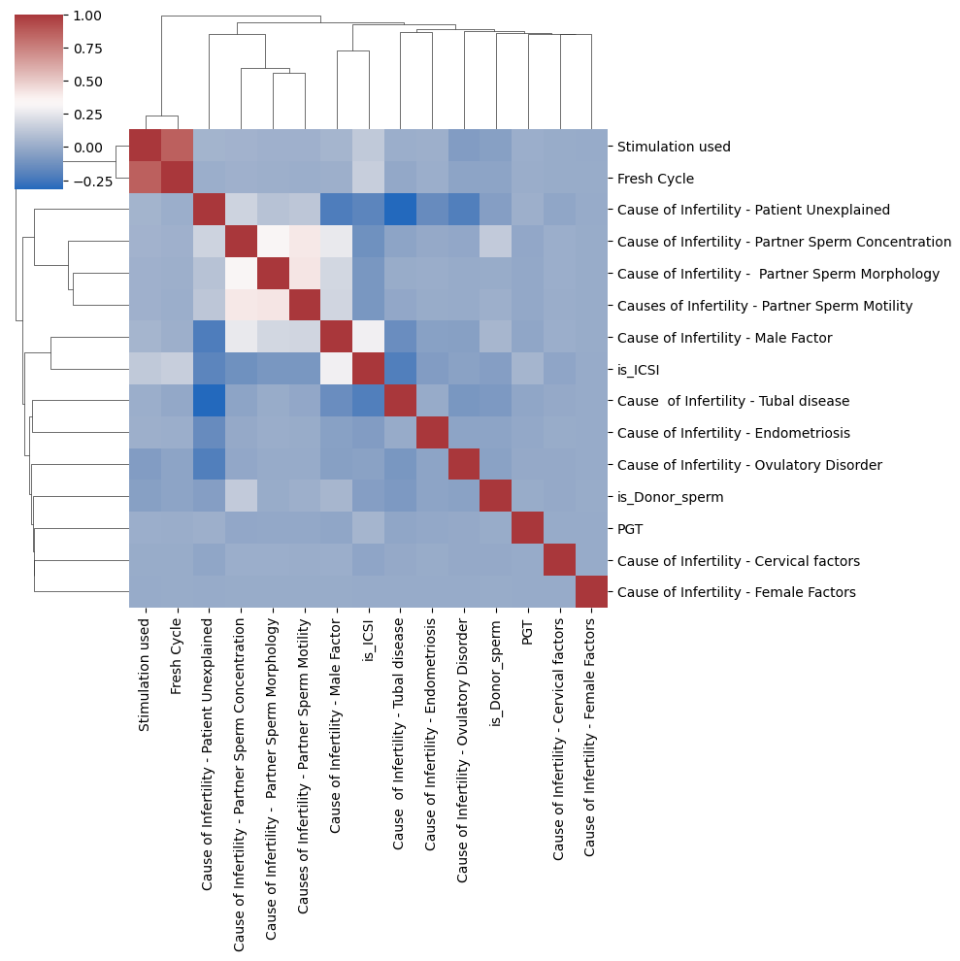
EDA using Hierarchically Clustered Correlation Heatmap
1991-2016
1991-2016
2017-2018
Fresh Cycle is often associated with Stimulation to produce more eggs
Male factor infertility tend to be linked with ICSI
Consistent with 2017-2018 data, Male factor infertility cause tends to coincide with Partner Sperm issues. They closely link with ICSI
Male factor infertility cause tends to coincide with Partner Sperm issues.

Slide 9
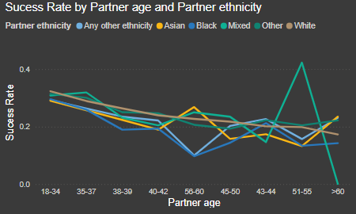
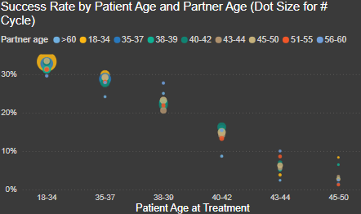
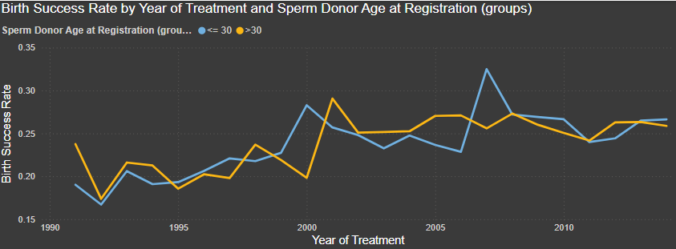
Exploratory Descriptive Analysis using Power BI
2017-2018
Visually speaking, average IVF treatment success rate is highest among partners younger than 35 years of age. Young partners (18-34) have the biggest overlap with young patients. Therefore, the patient age range needs to be fixed in statistical testing
1991-2016
Visually speaking, IVF treatment success rate trends upwards. When looking at Sperm Donors above 30 years of age vs below 30 years of age, the gap in success rate is not obvious, suggesting no significant male age impact, which will be tested later

Slide 10
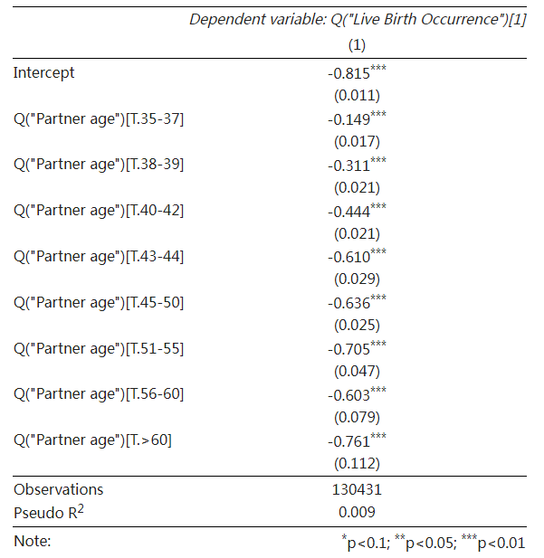
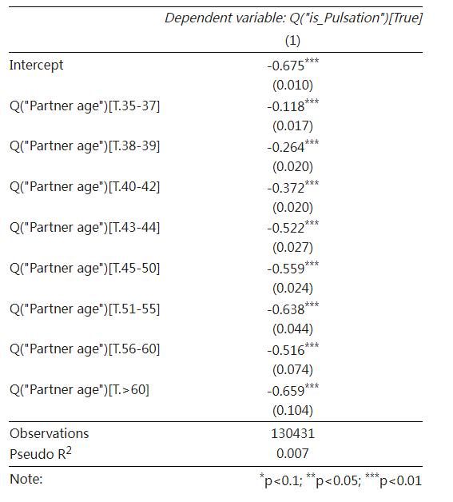
2017-2018 Partner Age Test
Compared to the baseline, the older a male partner, the less likely a treatment cycle leads to intrauterine foetal pulsation in early outcome and successful live birth
However, other factors such as patient age, ethnicity, infertility causes and treatment variations can play a role in combination with male age too.
The baseline for comparison is the youngest category in Partner Age: 18-34.
Each row represents the mean and standard deviation of coefficients compared to the benchmark.

Slide 11
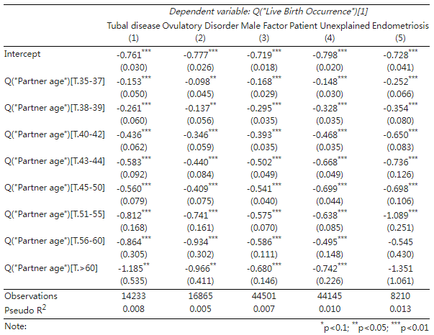
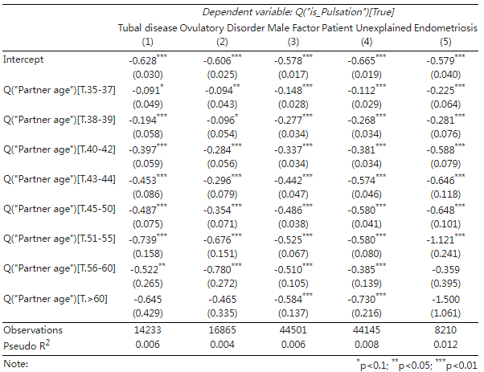
2017-2018 Partner Age controlled for Infertility Cause
When the infertility is caused by female factors (ovulatory disorder, tubal disease and endometriosis), male age’s effect is less significant
When the infertility is caused by male factors, the negative impact of increasing male age on successful birth is more significant.
The baseline for comparison is the youngest category in Partner Age: 18-34.
Each column represents the controlled infertility cause.

Slide 12
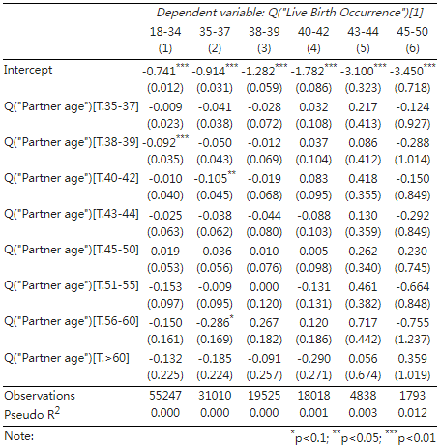
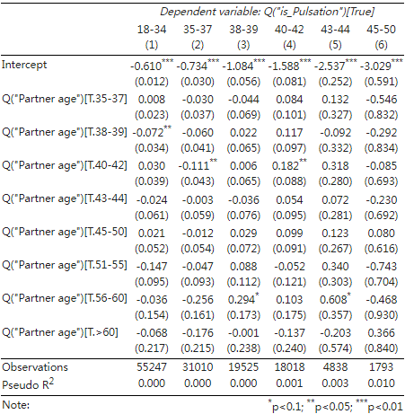
2017-2018 Partner Age controlled for Patient Age
The significance and direction of male age effects vary across different patient age groups.
For younger female patients, increasing male age has a negative impact on success rate.
For older female patients, increasing age of partner may increase the treatment success but the sample size makes this difficult to assess. This warrants factoring in ethnicity and treatment variations.
The baseline for comparison is the youngest category in Partner Age: 18-34.
Each column represents the controlled age group.

Slide 13
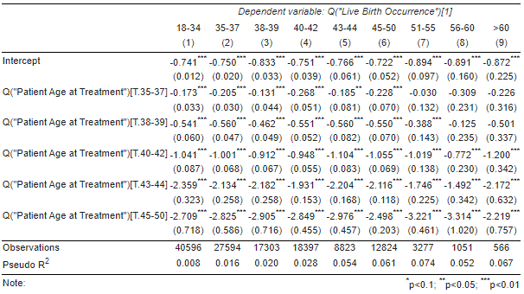
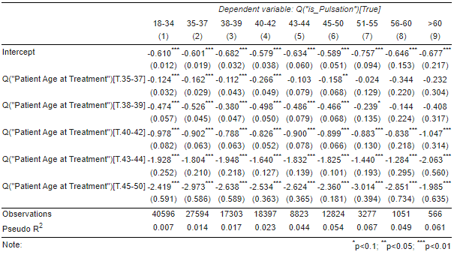
2017-2018 Partner Age controlled for Patient Age
If the male age is controlled, the negative correlation of live birth and pregnancy with higher female patient age is consistently significant across male age groups below 50 and sporadically significant for male aged above 50.
Together with the previous table, it can be deducted that male age does not exert as big an effect on fertility chance as female age does.
The baseline for comparison is the youngest category in Patient Age: 18-34.
Each column represents the controlled age group.
Notes:
Suggest delete slide 12 which is hidden

Slide 14
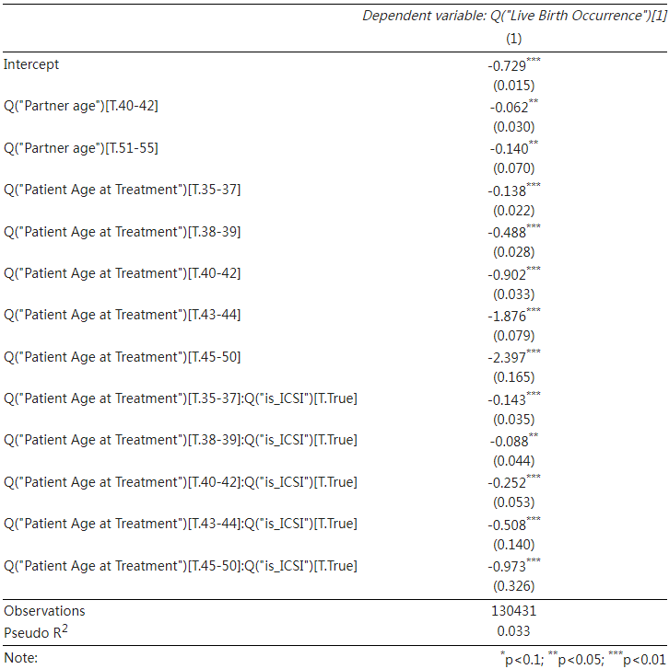
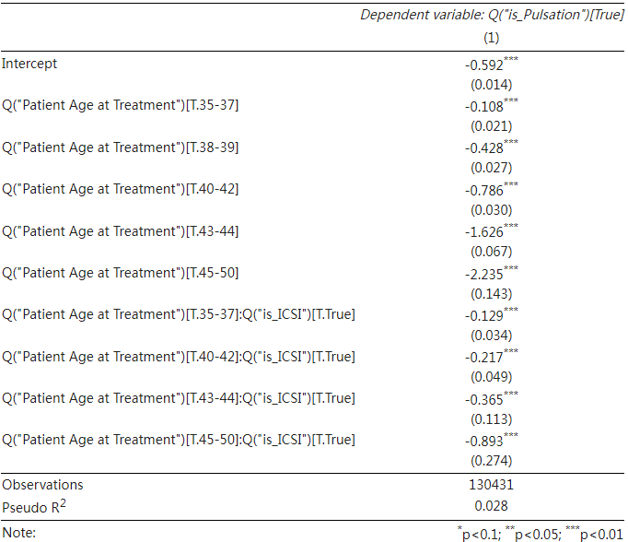
2017-2018 Partner Age: Patient Age: ICSI vs IVF
There is little statistical evidence to support ICSI’s positive effect on treatment success with older female patients.
Older female patients using ICSI can be even less likely to conceive and deliver birth successfully
Only the 5% significance levels are shown in the table

Slide 15
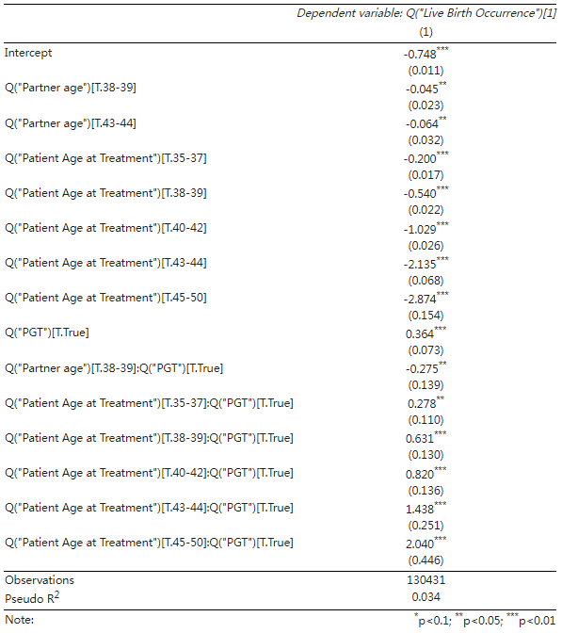
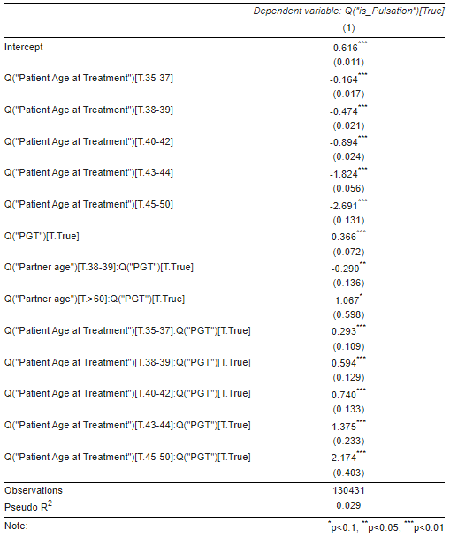
2017-2018 Partner Age: Patient Age: PGT vs non-PGT
There is enough statistical evidence to support PGT’s positive effect on treatment success.
Older partner and female patients treated using PGT are more likely to see positive treatment outcomes
Only the 5% significance levels are shown in the table

Slide 16
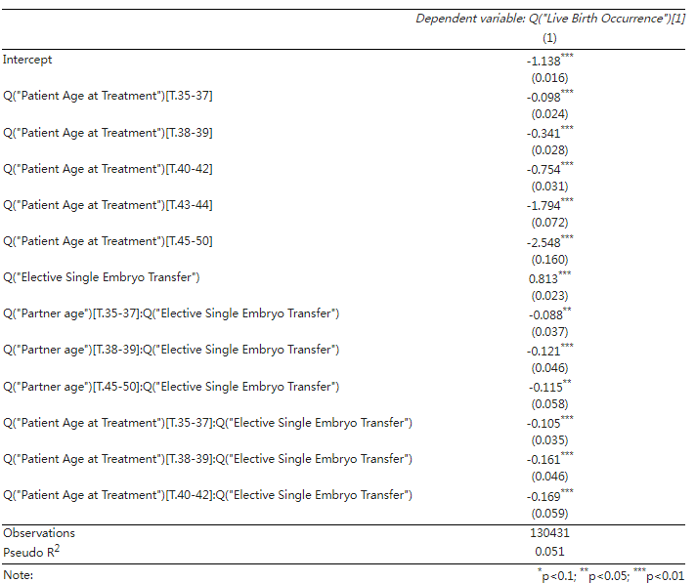
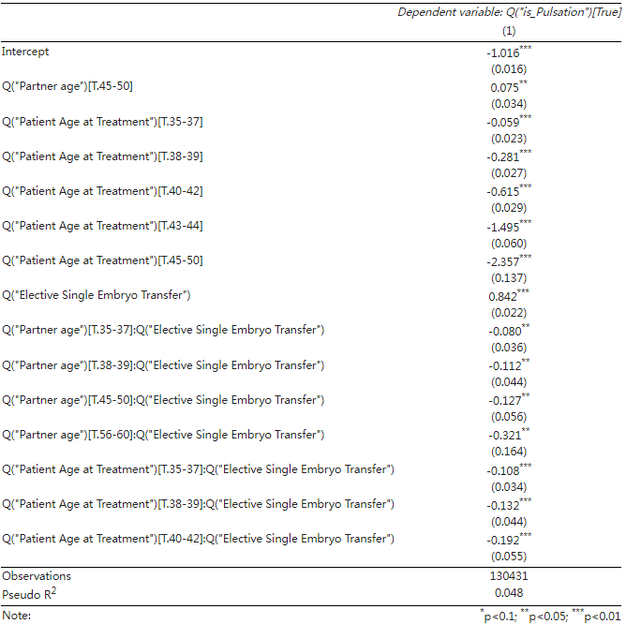
2017-2018 Partner Age: Patient Age: eSET vs non-eSET
There is no statistical evidence to support eSET’s positive effect on treatment success.
Older partner and female patients treated using eSET can be less likely to see positive treatment outcomes
Only the 5% significance levels are shown in the table

Slide 17
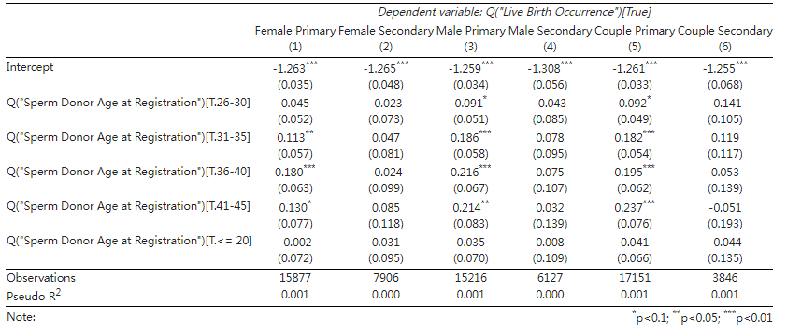
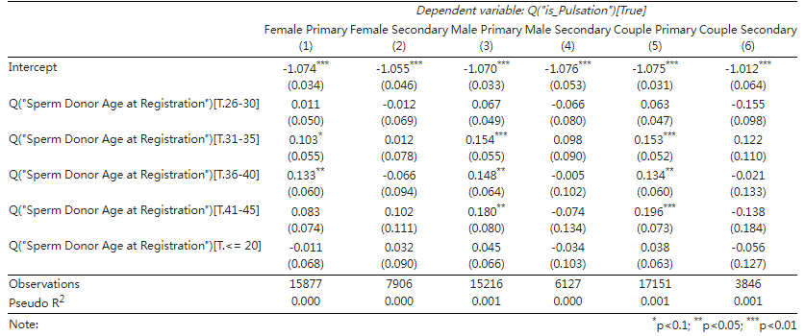
1991-2016 Donor Age controlled for Infertility Type
Negative impact of higher male age on pulsation seen and live birth is only spotted for the secondary infertility causes, which is not significant statistically.
For primary infertility causes, older sperm donors may appear to increase the chance of success but data is too few to establish conclusions
The baseline for comparison is the category in Sperm Donor Age 21-25.
Each column represents the controlled infertility type.

Slide 18
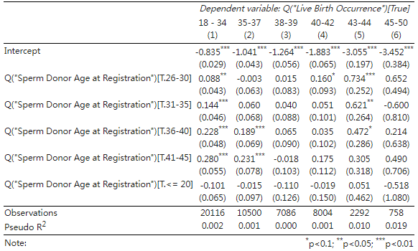
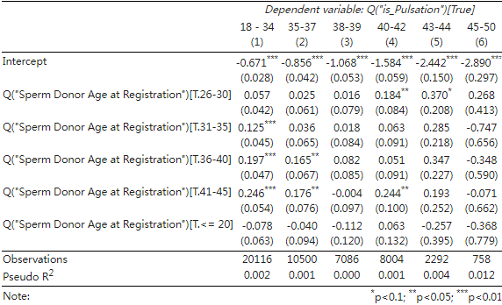
1991-2016 Donor Age controlled for Patient Age
There is no statistical evidence to show that younger male sperm donor has a higher chance of successful early outcome and birth
Instead, higher age of sperm donors may increase the chance of success in certain cases
The baseline for comparison is the category in Sperm Donor Age 21-25.
Each column represents the controlled age group

Slide 19
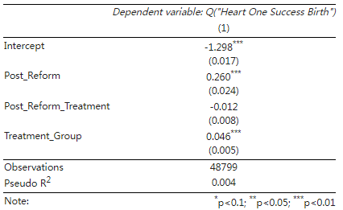
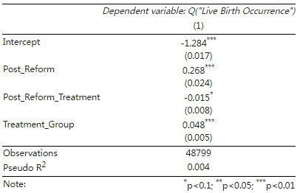
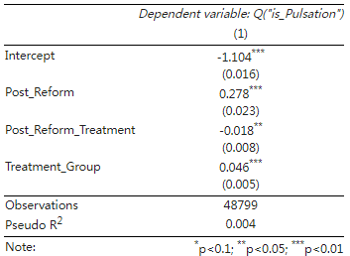
1991-2016 Difference-in-Difference: Legislative Change on Storage Length
Treatments received after 2009 are more likely have early outcome and successful birth
The treatment group cycles that freeze gametes
have more chance of leading to successful results
However, the combined effect of the reform and being in the treatment group does not turn out to be positive, implying the reform probably did not achieve the goal it aimed for. More research based on the storage length of frozen gametes is needed to understand the cause of the phenomenon
The interaction term is constructed based on the following two added columns:
The 2009 legislative reform allowed for extended storage of egg, sperms and up to 55 years, the treatment group in the difference-in-difference model can be defined as those samples who have 1 in the following columns: ['Fresh Eggs Stored’, 'Embryos Stored For Use By Patient’], who are likely to benefit from this extended storage.
Post_Reform: Indicates whether the observation is before or after the legislative reform in 2009.

Slide 20
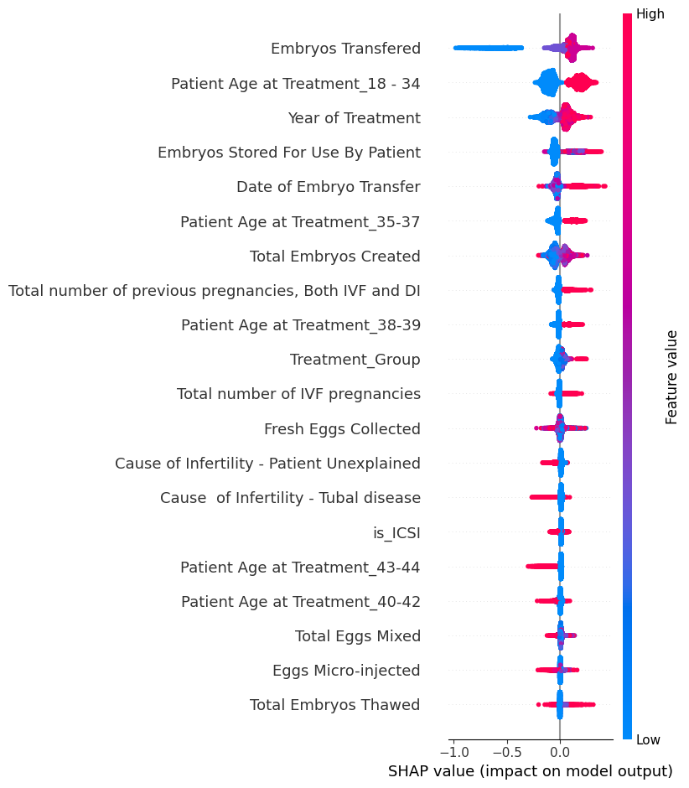
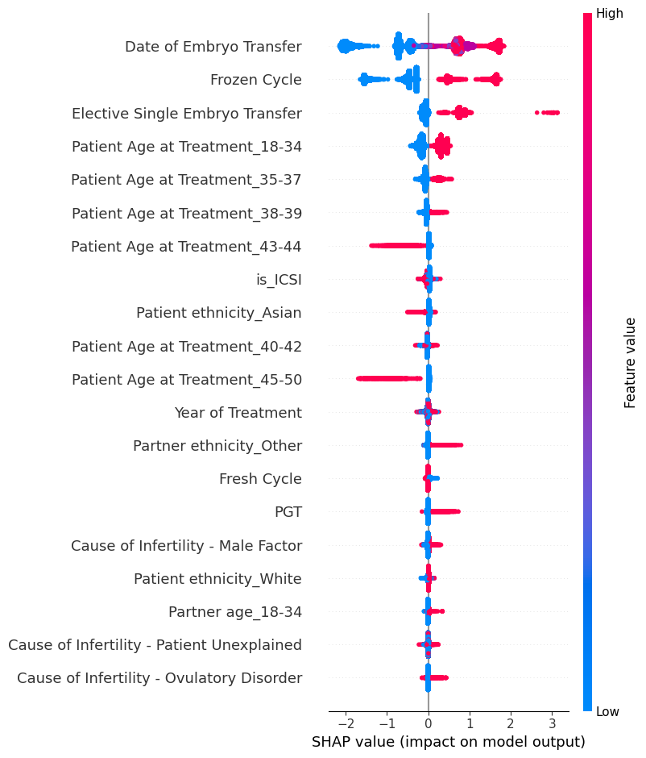
Insights from Machine Learning Models
More embryos transferred, the higher the chance of successful live birth
Using PGT and eSET can improve chance of success
Treatment year > 2009 more likely to succeed
Lower patient age contributes to treatment success
Lower partner age contributes to successful live birth
Light GBM Regressor on 1991-2016 data
XG Boosting Classifier on 2017-2018 data

Slide 21
Conclusion and Recommendations
Conclusions
Recommendations
There is empirical evidence for higher male partner age negatively affecting IVF treatment outcome
There is in general no empirical evidence from HFEA data from 1991-2016 for increasing male donor sperm age between 18 to 45 negatively affecting IVF success rates. Indeed, there is some suggestion that paradoxically increasing male sperm donor age may have improve IVF success rates. This may be erroneous due to small sample size.
It is not possible to conclude, based on the data publicly available, whether the 2009 legislative change on the duration that gametes can be frozen has any effect on the success rates of IVF treatment.
PGT in women over 35 years of age leads to higher clinical pregnancy and livebirth rates
eSET is not an effective treatment in women over 35 years of age
Prioritize strategies and provide educational resources to promote earlier treatment for younger partners.
Allocate more resources towards young partners while still monitoring sperm donor age.
Promote PGS and PGD in treatment cycles that involve elder patients and male partners. Provide counseling and support for older patients.
Use of eSET is mainly to reduce multiple pregnancy rate, rather than improve live birth rate

Slide 22



Special Course Training (30 hours)
To have a better understanding of the subject, I finished three online courses on reproduction science in which I learnt of the human anatomy, common causes of infertility and their treatments.

Slide 23
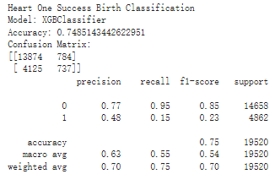
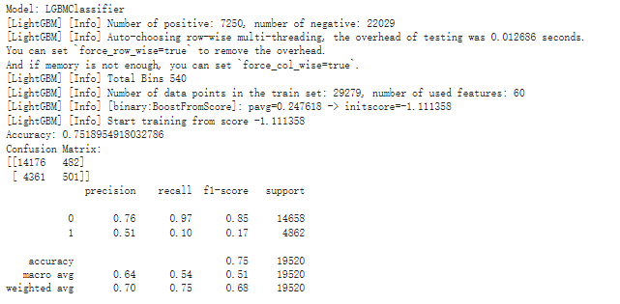
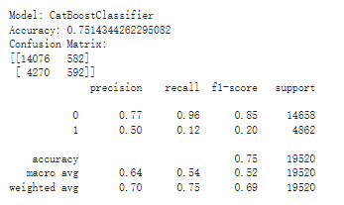
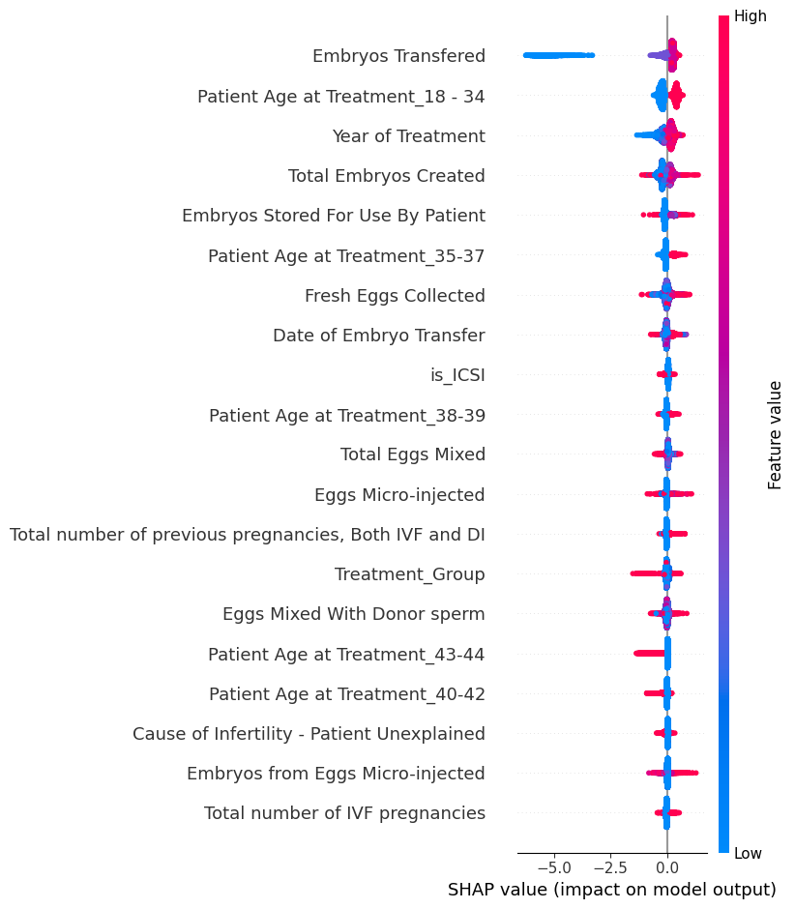
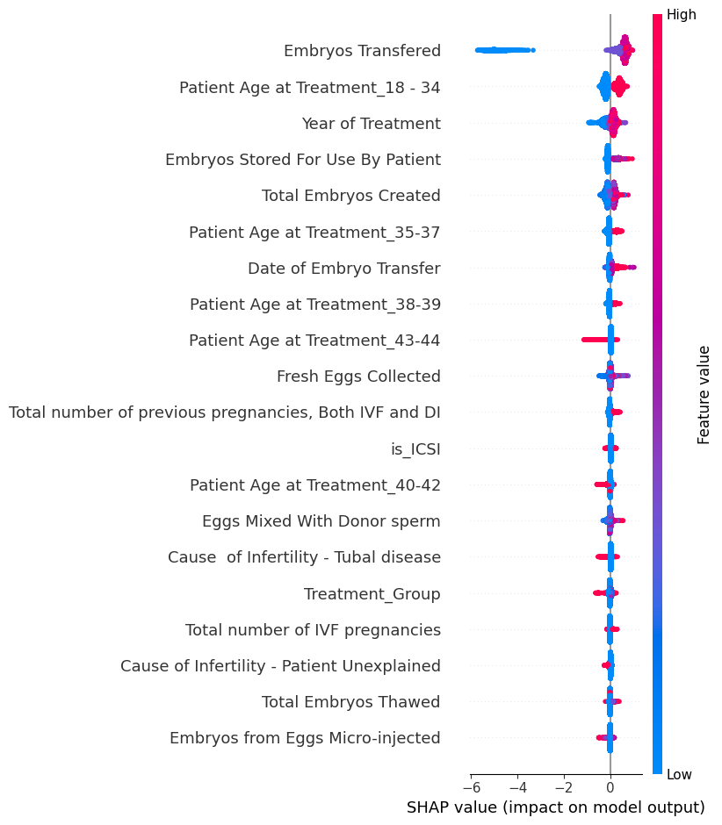
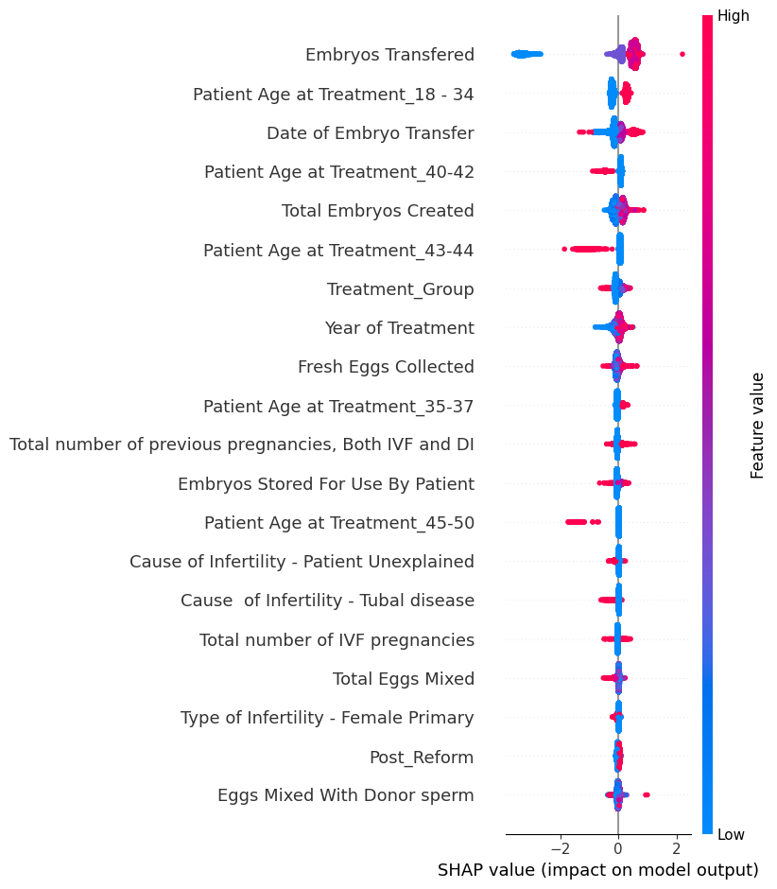
1991-2016 Machine Learning: Classification of Birth Success
XGBoost Classifier
Light GBM Classifier
CatBoost Classifier

Slide 24
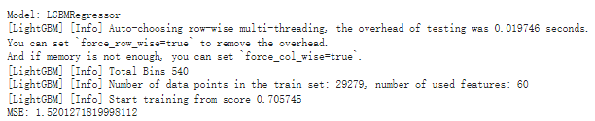
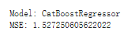
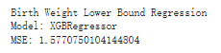
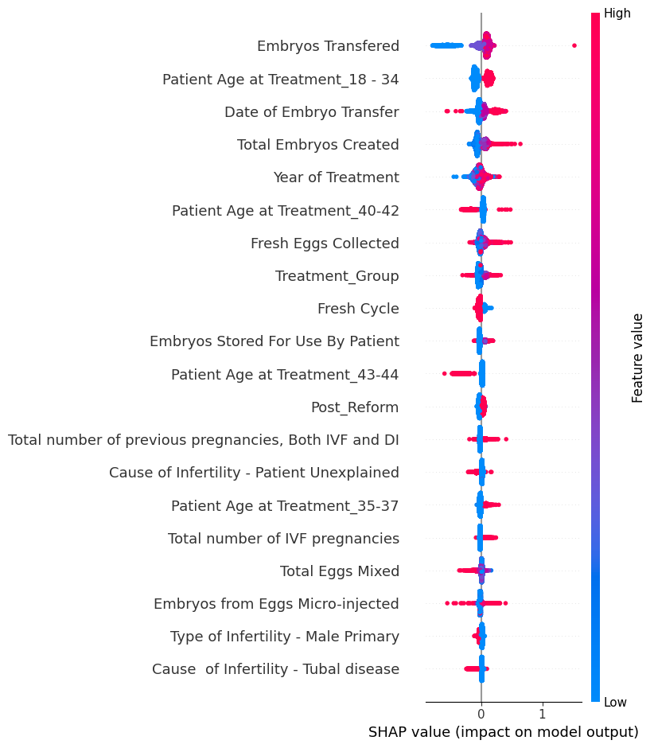
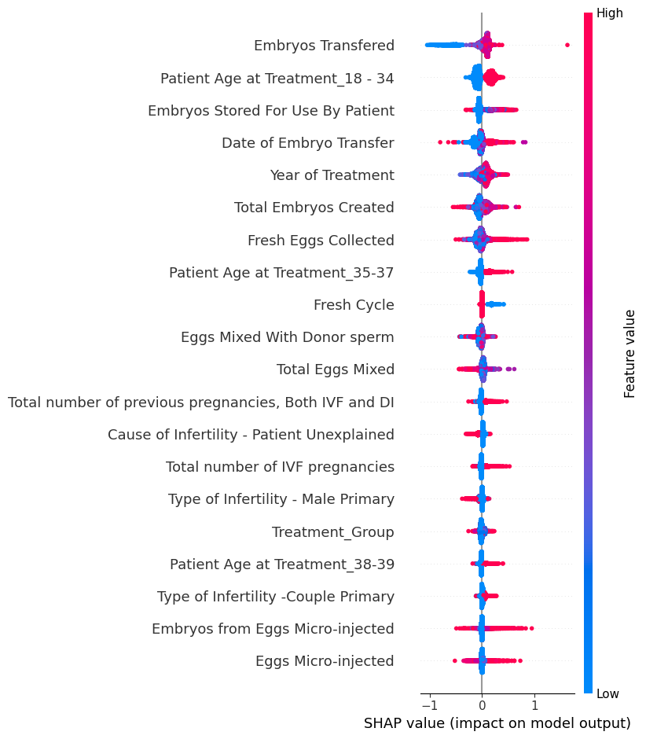
1991-2016 Machine Learning: Regression on Birth Weight
Light GBM Regressor
CatBoost Regressor
XGBoost Regressor

Slide 25
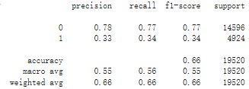
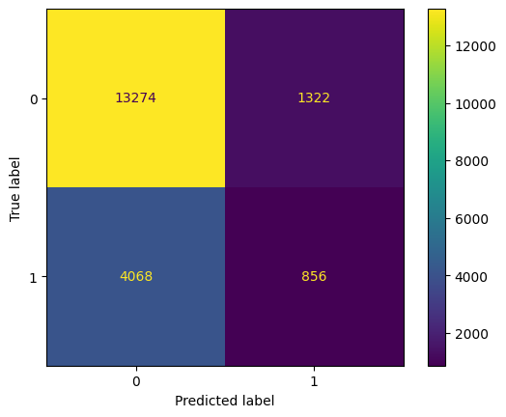
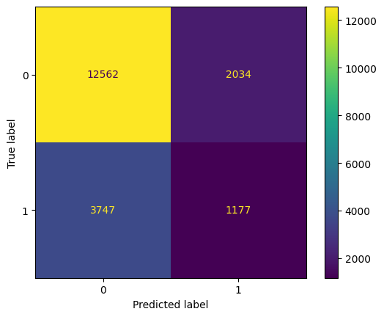
1991-2016 Machine Learning KNN, Random Forest, Voting Classifier
Fine tuned KNN model using optuna
Fine tuned Random Forest model using optuna
Out-of-Sample Performance for Soft Voting Classifier combining KNN and Random Forest
Confusion Matrix for Random Forest
Confusion Matrix for KNN

Slide 26
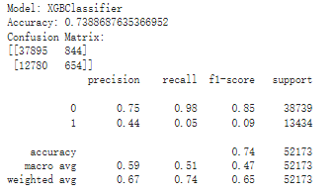
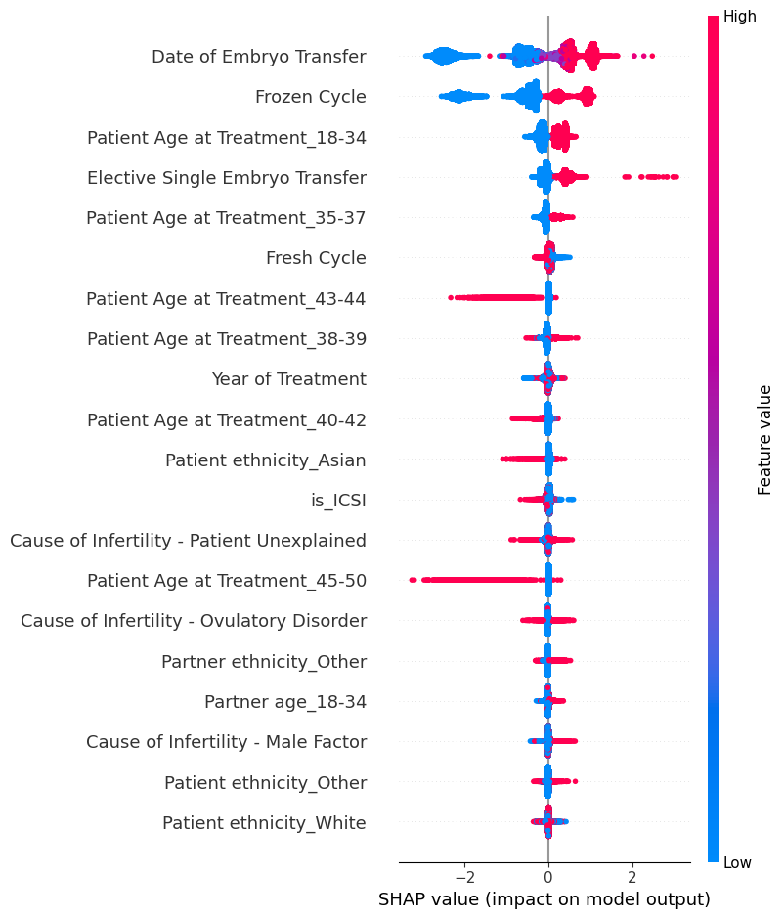
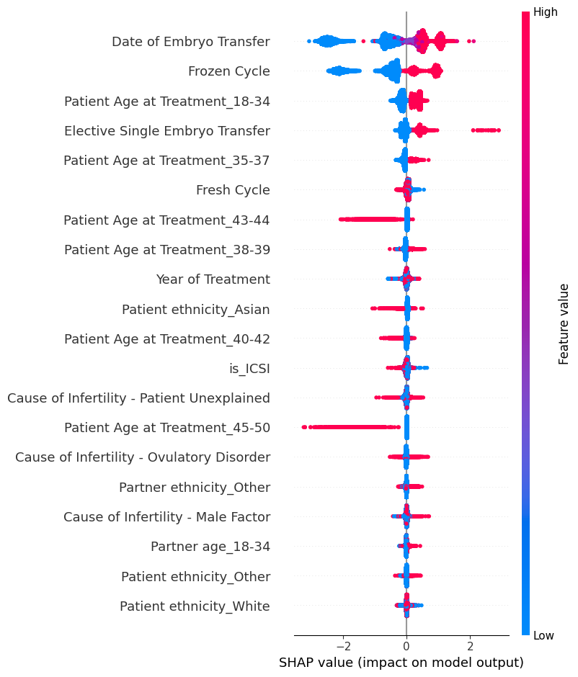
2017-2018 Machine Learning: XGBoosting
XG boosting overfits the 2017-2018 data

Slide 27
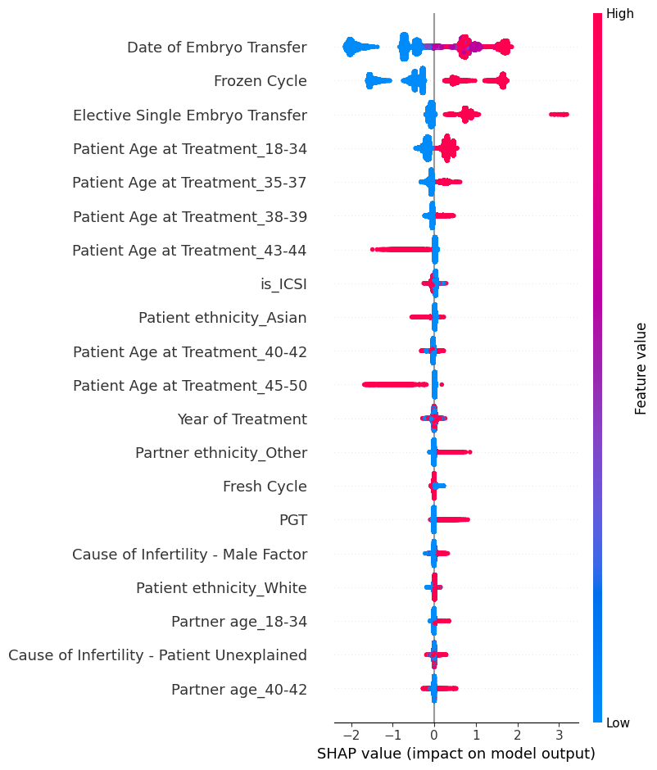
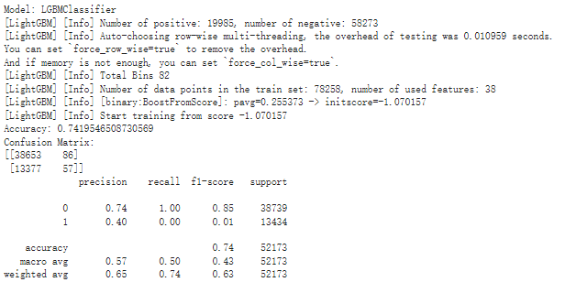
2017-2018 Machine Learning: Light GBM
Light GBM failed on the 2017-2018 data

Slide 28
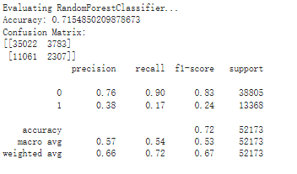
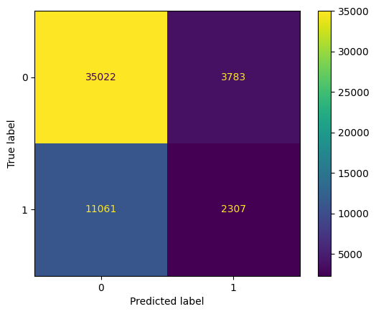


2017-2018 Machine Learning: KNN, Random Forest and Voting Classifier
Confusion Matrix for Random Forest
Confusion Matrix for Random Forest
Out-of-Sample F1 Score for Soft Voting Classifier combining KNN and Random Forest
Fine tuned KNN model using optuna
Fine tuned Random Forest model using optuna

